Slide 1
From last lesson
6(a + 4) = 6a + 24 2. g(g - 2) = g² -2g
4p(2 + 1) = 8p + 4p 4. 6(t + t²) = 6t + 6t²
5. -2c(c + d) = -2c² -2cd 6. -b(b – 4) = -b² +4b

Slide 2
24
7
30
Expanding 2 Brackets
Date
EQ – How do you expand 2 brackets?

Slide 3

24
7
30
Expanding 2 Brackets
Date
EQ – How do you expand 2 brackets?
What is the distributive law?
to distribute means to expand. To distribute 2 brackets we can use the FOIL method.
$$\left(p+l\right)\left(a+n\right)$$

Slide 4

24
7
30
Expanding 2 Brackets
Date
EQ – How do you expand 2 brackets?
What is the distributive law?
to distribute means to expand. To distribute 2 brackets we can use the FOIL method.
First
$$\left(p+l\right)\left(a+n\right)$$
How do I expand Brackets?
$\left(p+l\right)\left(a+n\right)$ = $pa$

Slide 5

24
7
30
Expanding 2 Brackets
Date
EQ – How do you expand 2 brackets?
What is the distributive law?
to distribute means to expand. To distribute 2 brackets we can use the FOIL method.
First
Outer
$$\left(p+l\right)\left(a+n\right)$$
How do I expand Brackets?
$\left(p+l\right)\left(a+n\right)$ = $pa+pn$

Slide 6
24
7
30
Expanding 2 Brackets
Date
EQ – How do you expand 2 brackets?
What is the distributive law?
to distribute means to expand. To distribute 2 brackets we can use the FOIL method.
First
Outer
Inner
$$\left(p+l\right)\left(a+n\right)$$
How do I expand Brackets?
$\left(p+l\right)\left(a+n\right)$ = $pa+pn+la$

Slide 7
24
7
30
Expanding 2 Brackets
Date
EQ – How do you expand 2 brackets?
What is the distributive law?
to distribute means to expand. To distribute 2 brackets we can use the FOIL method.
First
Outer
Inner
Last
$$\left(p+l\right)\left(a+n\right)$$
How do I expand Brackets?
$\left(p+l\right)\left(a+n\right)$ = $pa+pn+la+ln$
The PLAN has been FOILed

Slide 8
24
7
30
Expanding 2 Brackets
Date
EQ – How do you expand 2 brackets?
What is the distributive law?
to distribute means to expand. To distribute 2 brackets we can use the FOIL method.
First
Outer
Inner
Last
$$\left(p+l\right)\left(a+n\right)$$
How do I expand Brackets?
$\left(p+l\right)\left(a+n\right)$ = $pa+pn+la+ln$
The PLAN has been FOILed

Slide 9
24
7
30
Expanding 2 Brackets
Date
EQ – How do you expand 2 brackets?
What is the distributive law?
to distribute means to expand. To distribute 2 brackets we can use the FOIL method.
First
Outer
Inner
Last
$$\left(p+l\right)\left(a+n\right)$$
How do I expand Brackets?
$\left(p+l\right)\left(a+n\right)$ = $pa+pn+la+ln$
The PLAN has been FOILed
Examples
(x² + 3)(x + 4) = x²•x +x²•4 + 3•x +3•4
= x³ + 4x² + 3x + 12
(2d + 4)(d - 3) = 2d•d +2d•-3 + 4•d + -3•4
= 2d² + -6d + 4d + -12
= 2d² -2d -12
(x + 4)² = (x+4) (x+4)
= x•x +x•4 + x•4 + 4•4
=x² + 4x + 4x +16
=x² + 8x +16

Slide 10
So does this really work?
What is the value of;
(2 + 5) x (4 + 6) = 7 x 10 = 70
Or
2x4 + 2x6 + 5x4 + 5x6 =
8 + 12 + 20 + 30 = 70
What is the value of;
(4 - 2) x (7 + 3) = 2 x 10 = 20
Or
4x7 + 4x3 - 2x7 - 2x3 =
28 + 12 - 14 - 6 = 20

Slide 11




LHS – complete the following using the foil method

Slide 12
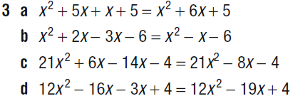
Answers
Now complete Exercise 18.13 from your text on page 252

Slide 13
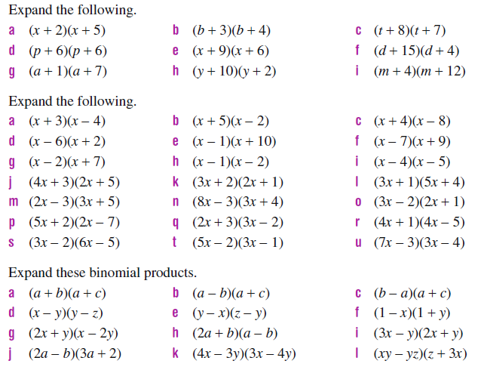
Expanding – Alternative / extra questions
1
2
3

Slide 14
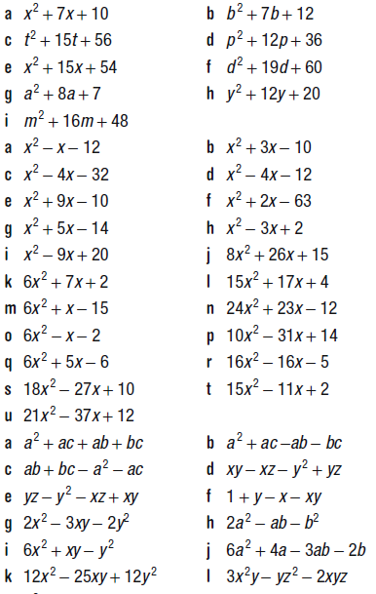
Answers
1
2
3

